Slide 1

Group 11
Level 4/5 Group 11
Razvan Muresan
Tyler Martignetti
Joseph Shuttlewood
John Rance
razvan muresan
joseph shuttlewood
tyler martignetti
john rance

Slide 2
DEMO

Slide 3
Key features

Slide 4
What players enjoy

Slide 5
Where players struggle

Slide 6

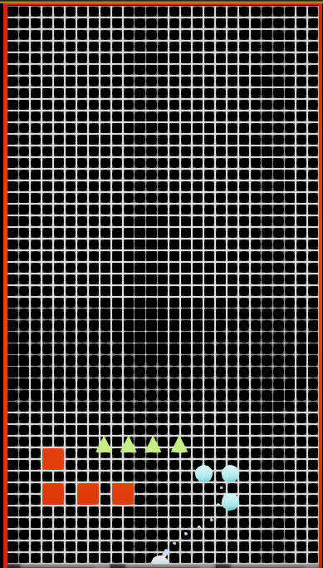
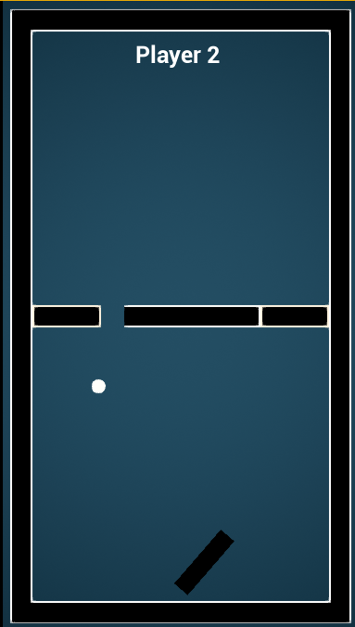
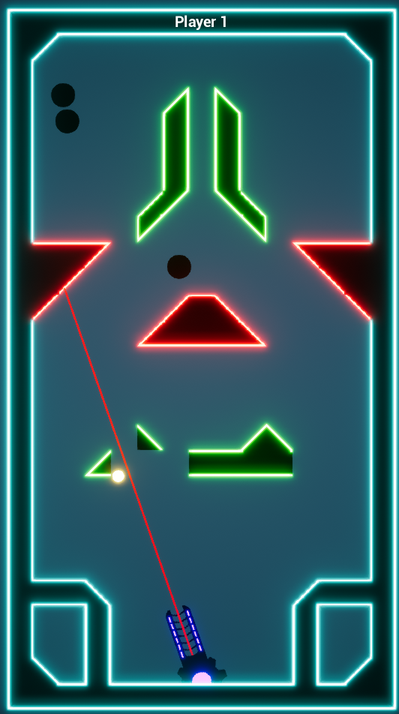
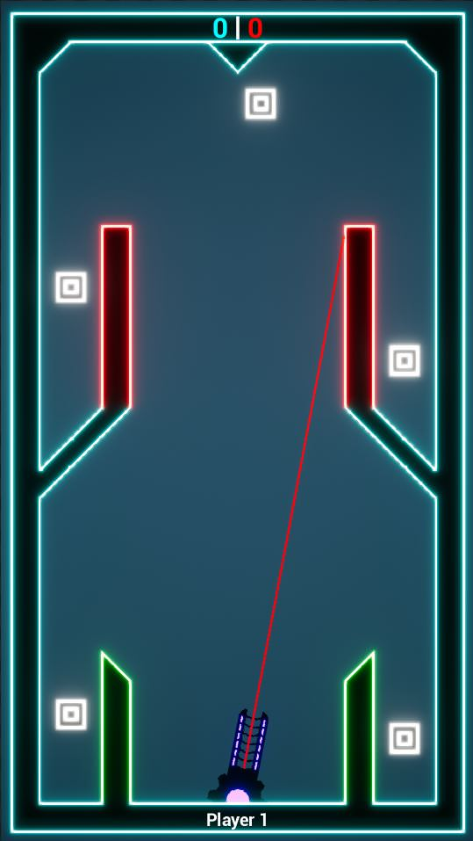
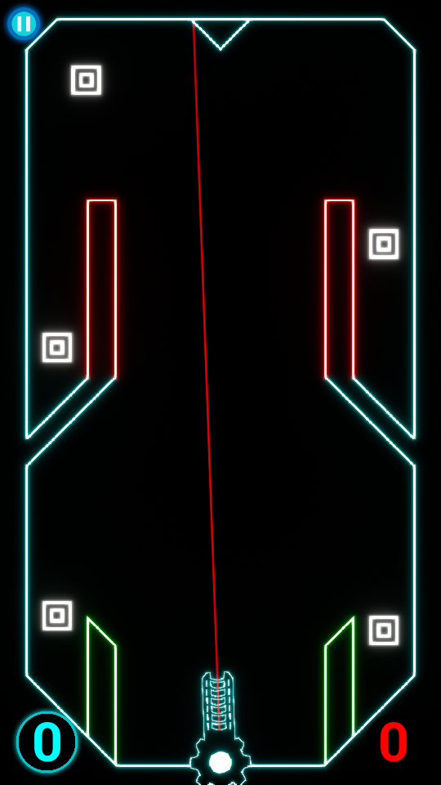
Our Game & iterations
16th February
21st February
26th February
5th March
Today

Slide 7
Feedback received
UI Elements
Score
Player turn indicator
Pause button and hardware buttons
Tutorial Levels
Difficulty of Levels – too hard
Design choices – neon theme

Slide 8
Critical mechanical changes
Moving blocks were changed drastically in every single level
Removed targets from bottom corners of levels
Removed a lot of triangle blocks

Slide 9
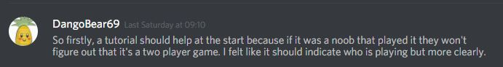
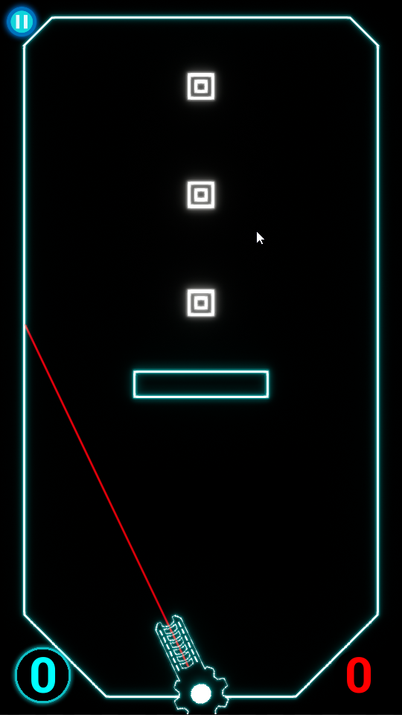
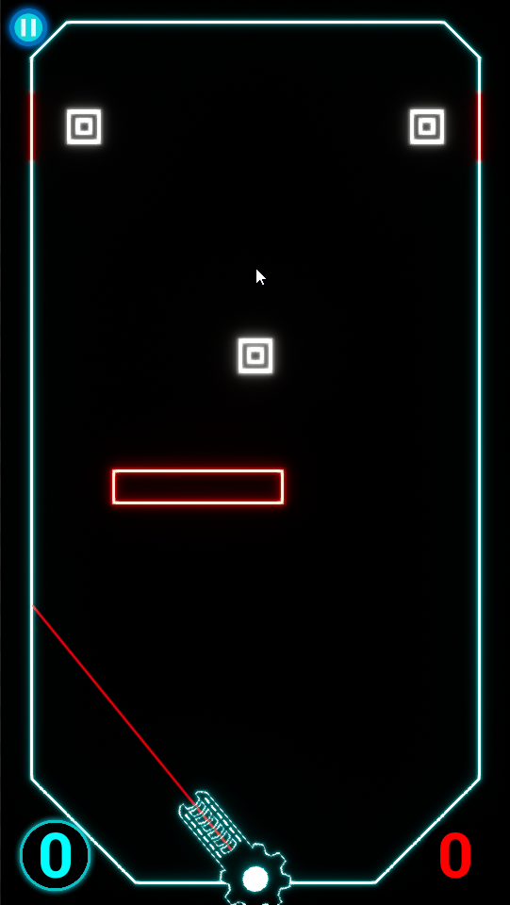
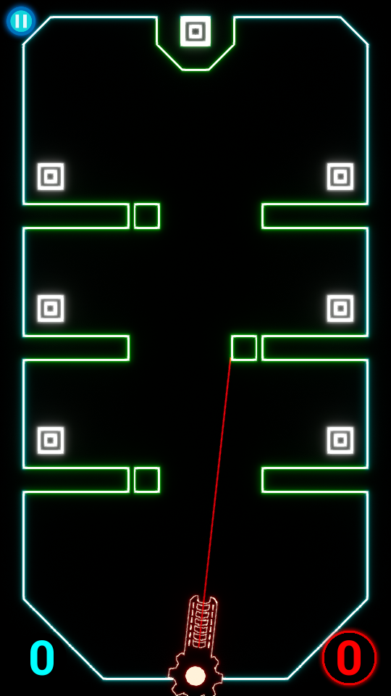
Feedback
Tutorial Level 1
Tutorial Level 2
Tutorial Level 3

Slide 10
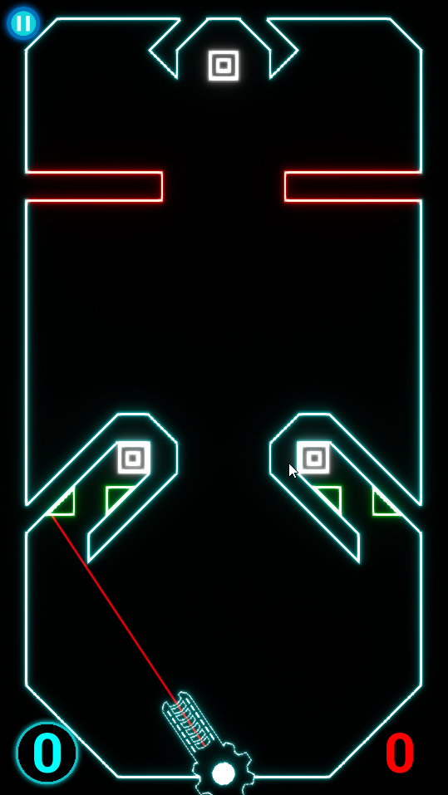
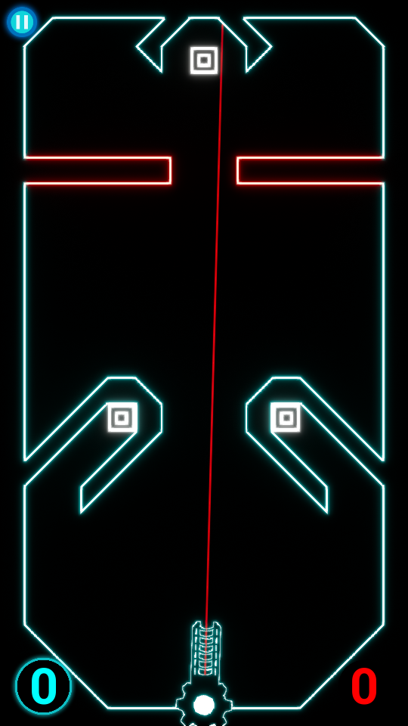
Iterations based on feedback

Slide 11
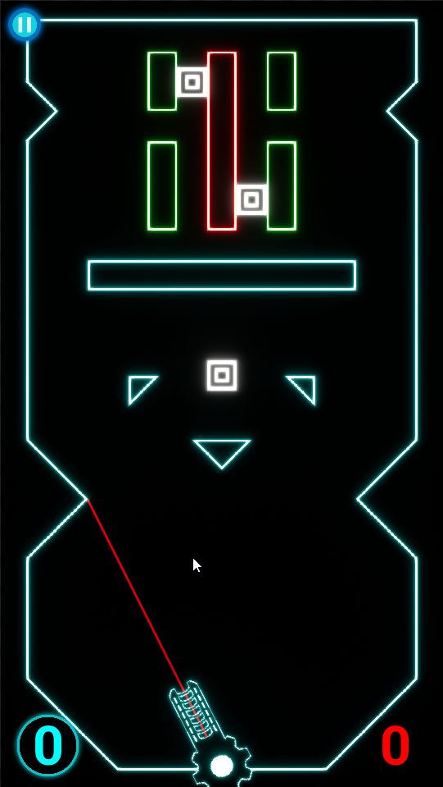
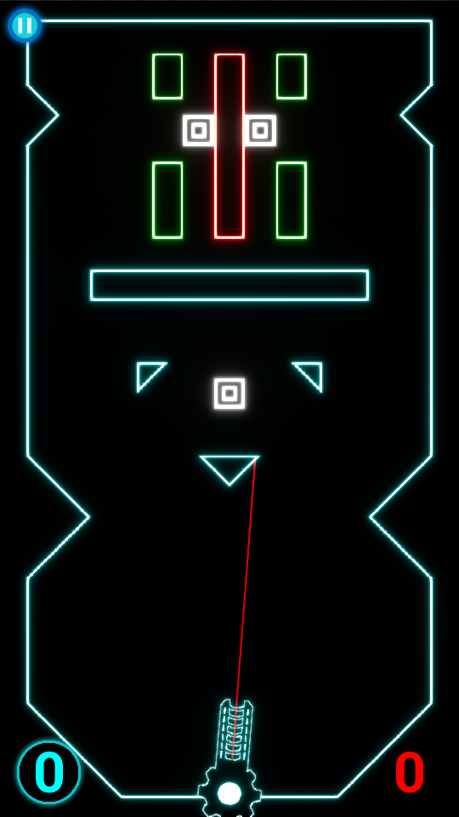
Iterations based on feedback

Slide 12
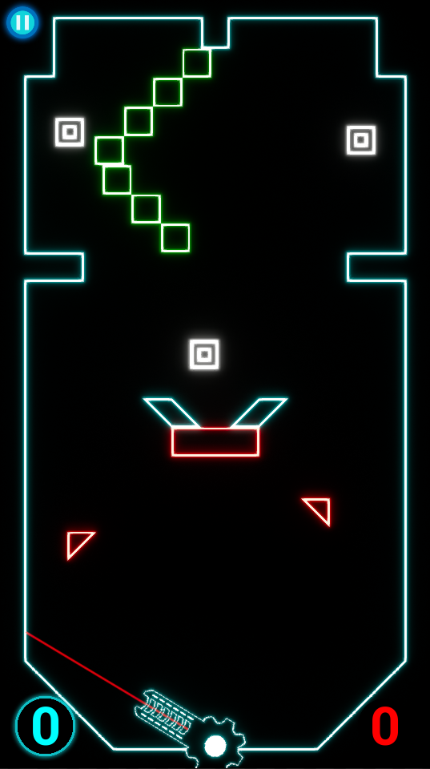
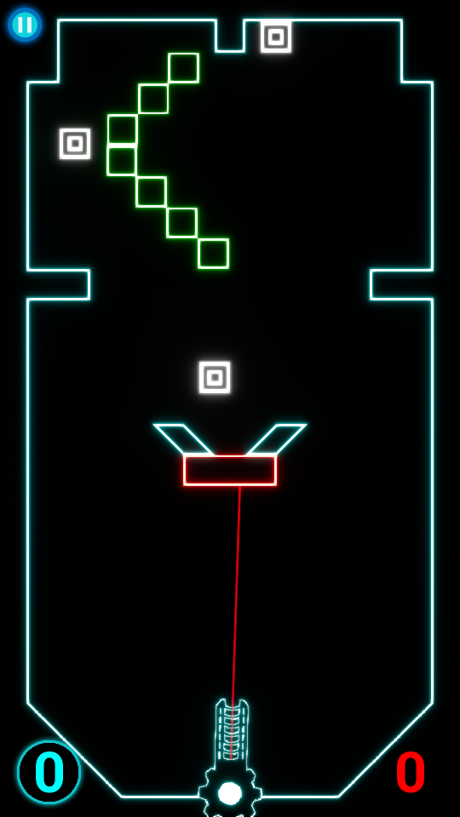
Iterations based on feedback

Slide 13
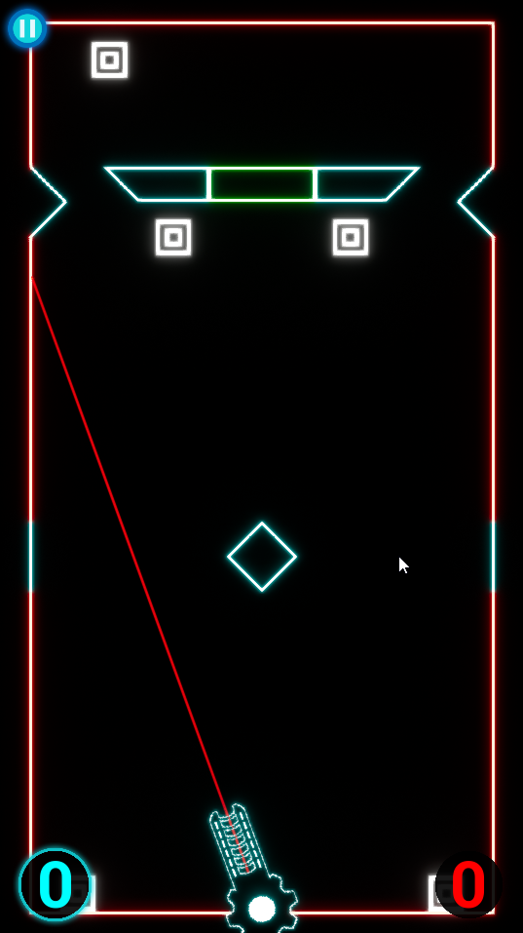
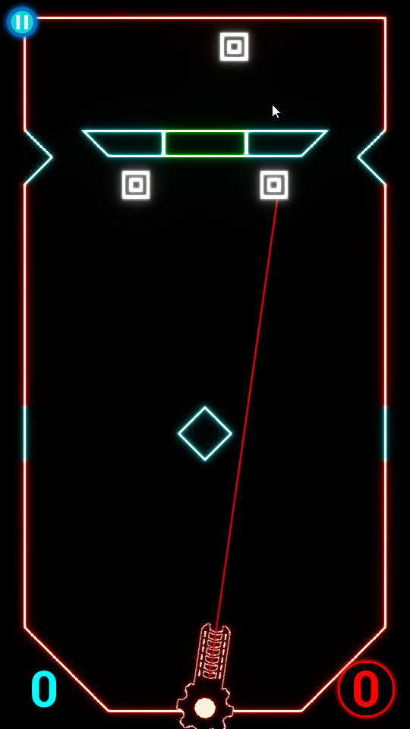
Iterations based on feedback

Slide 14
Implementation of hard mode
Changed all levels to appeal to a more casual player base
Added our previous levels to a toggle-able ‘Hard Mode’
Levels consist of less moving parts, more targets

Slide 15
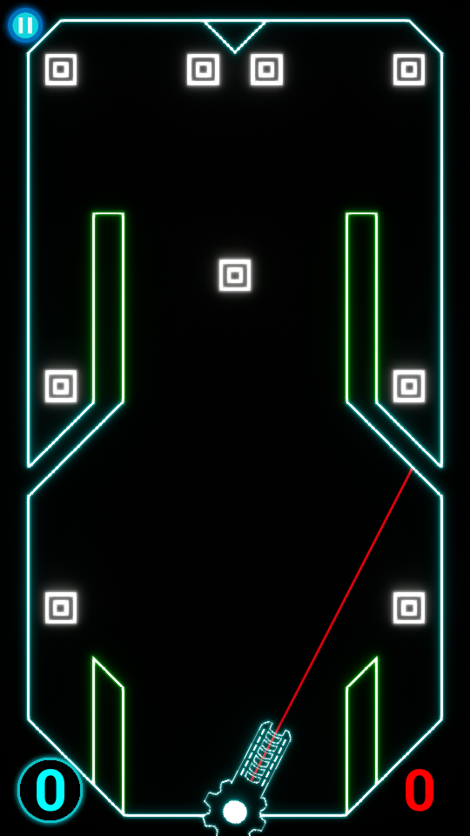
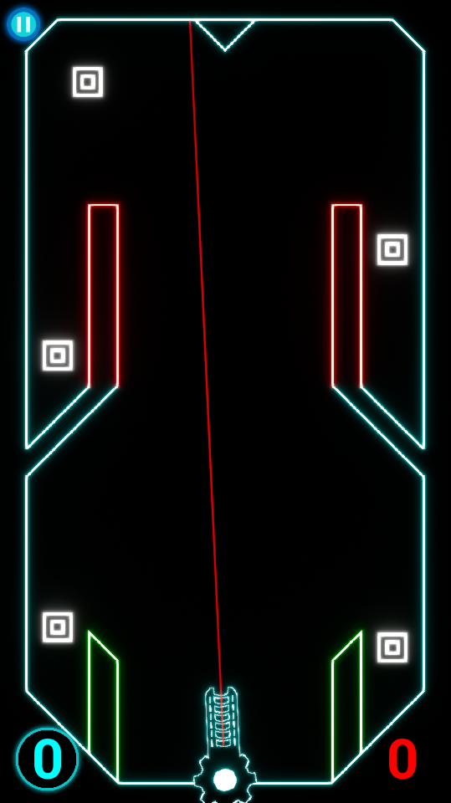
Normal levels vs hard mode

Slide 16
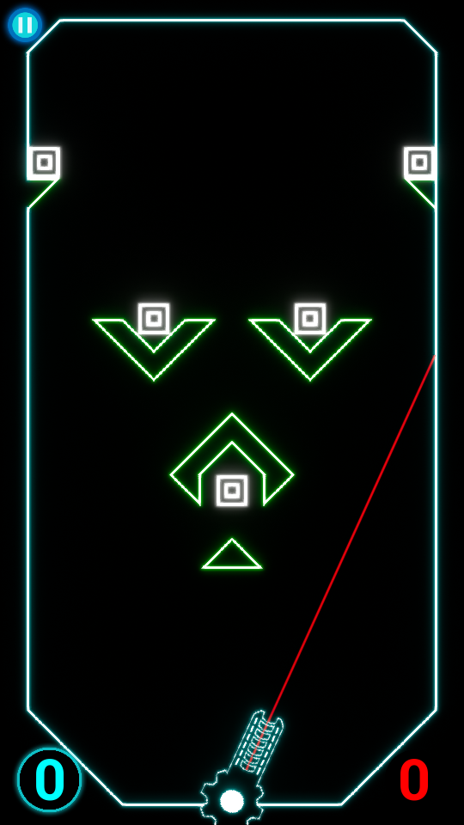
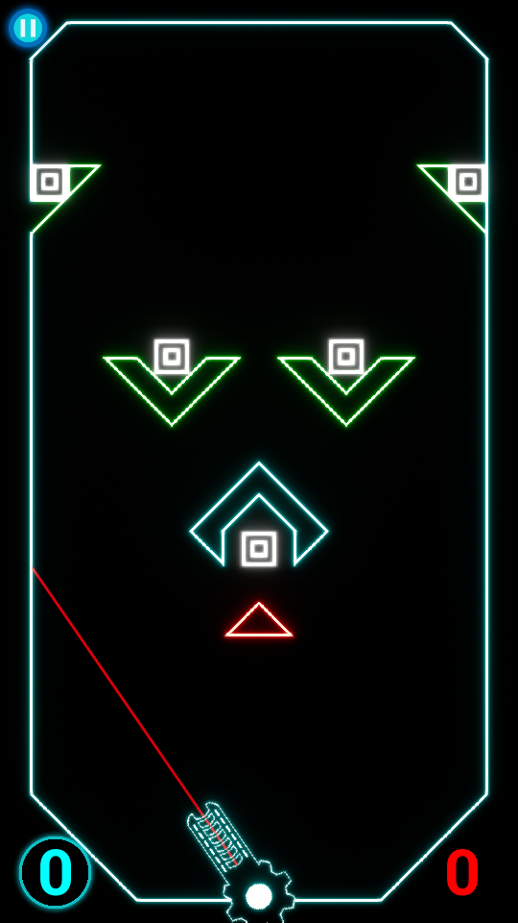
Normal levels vs hard mode

Slide 17
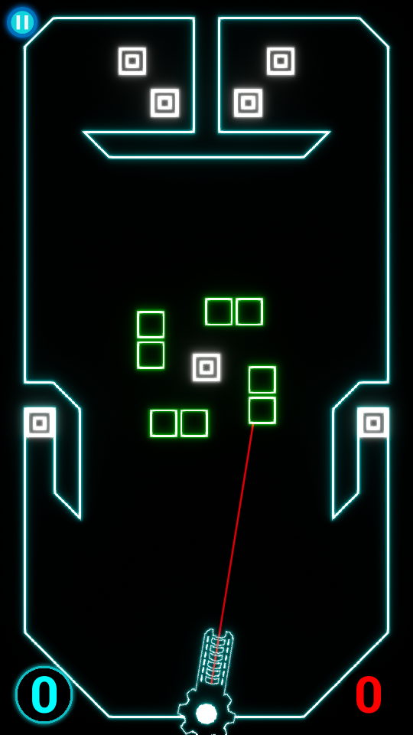
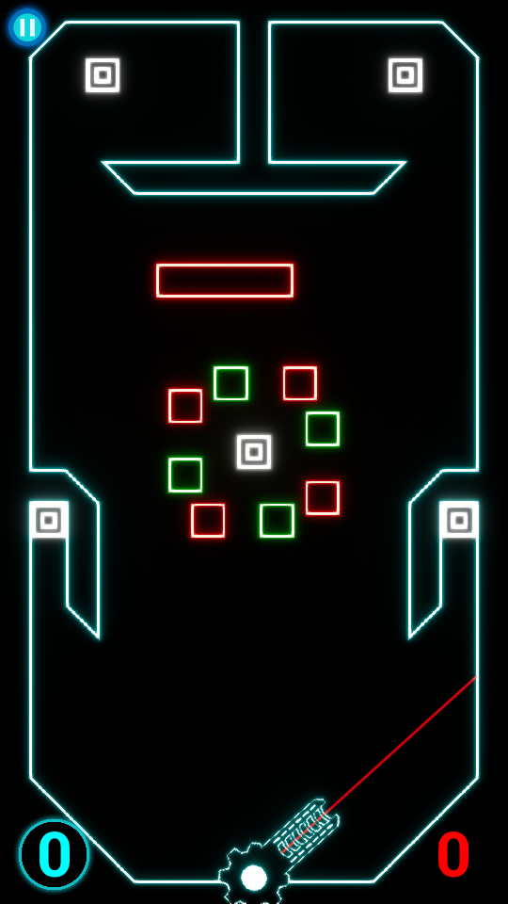
Normal levels vs hard mode

Slide 18
Key design lessons

Slide 19
Key programming lessons

Slide 20
Key managements lessons

Slide 21
Questions

